Slide 1
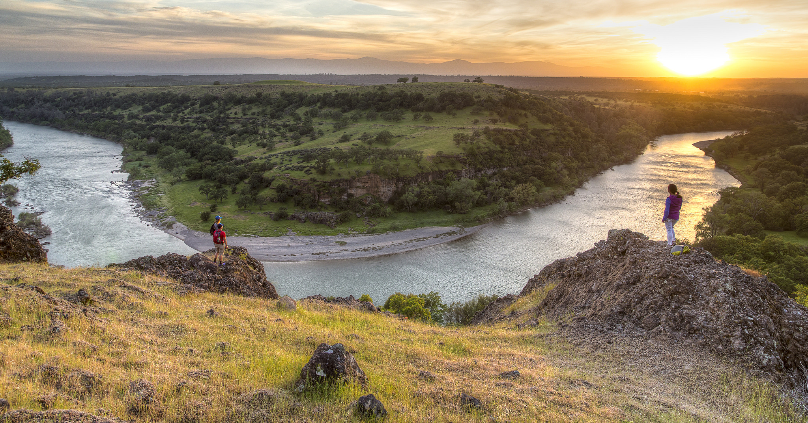
Title Text
Optional Supporting Text
Supporting Text
Notes:
*** Replace title page photo with a map of the planning area (include color legend for the map)

Slide 2
Summary of Decision - Alt. ?
Include Purpose and Need
Brief summary of preferred/proposed alternative(s)
Include some context (revision, amendment, court ordered?)
What is the decision to be made? (i.e., is the decision space limited to one or two issues?)
Highlight major changes between existing RMP and this RMP
Rationale -- why choose that alternative?
Notes:
Include energy related resources (ex. Gold, copper, wind, solar, etc. ) and major issues with some numbers/acres and context here. Be brief, but also informative.

Slide 3
Secretarial Priorities
Include impact on jobs
Secretary Zinke’s Top Ten Priorities – • Create a conservation stewardship legacy second only to Teddy Roosevelt • Sustainably develop our energy & natural resources • Restore trust and be a good neighbor • Ensuring sovereignty means something. • Increase revenues to support DOI and national interests • Protect our people and the border. • Strike a regulatory balance. • Modernize our infrastructure. • Reorganize DOI for the next 100 years. • Achieve our goals and lead our team forward.
Notes:
Use socio econ report, and list jobs in the local community that interact with BLM land (ex. Hunting & guiding, livestock grazing, minerals development, etc.). If there is no effect, say so! If there is an increase in jobs highlight.

Slide 4
Stakeholders
Summarize stakeholder positions, particularly regarding preferred/proposed alternative(s)
Include perspectives from Elected Officials
Notes:
Start with local counties and state gov’t, then list others. Talk about (don’t write) what was important in scoping/public comments. Identify cooperating agencies. Identify if they were favorable to the preferred alt.

Slide 5
Changes to Resource Uses
Describe how preferred/proposed alternative would change and/or limit resource uses (compared to previous decision).
What are the flexibilities on the implementation level with respect to resource uses?
Include acreages if resource uses are being limited/opened
Include rationale and appropriate analysis, if applicable
Include information about salient environmental impacts and resource conflicts (land use restrictions, transportation and access limitations, and proposed resolution to conflicts.
Notes:
Any change to availability to energy (open/closed) state here. Also any major issues.
Identify the increase or decrease from no action and preferred.

Slide 6
Schedule
List important dates & next steps.
Court ordered or other mandated deadline?

Slide 7
Summary of Alternatives
This and the following slides should present the relevant comparative tables of alternatives by resource or designation, as well as any other significant information or context
Ensure that background includes information about acreages impacted.
 | Alternative A (No Action) | Alternative B | Alternative C | Alternative D (Preferred)
Livestock Grazing Acreage Allocations
Open | 1,598,198 (76.4%) | 0 (0%) | 2,083,232 (99.6%) | 2,087,759 (99.8%)
Closed | 493,120 (23.6%) | 2,091,308 (100%) | 8,115 (0.04%) | 3,594 (0.02%)

Slide 8
Continue with other info & maps of relevance. Order slides that begin with issues that address the Administration's Priorities, such as energy, jobs, partnerships, etc. and follow with other plan related information.
Plan for additional slides to address any questions, and
Beware that all slides may not be presented based on unanticipated questions.

